Slide 1


ANALYSIS ON EMERGING TECHNOLOGIES
SAAEMA ASLAM WADKAR
28 July, 2024

Slide 2

Outline
01
05
Discussion
Findings & Implications
Executive Summary
02
06
Introduction
Conclusion
03
07
Methodology
Appendix
04
Results
Visualization- Charts
Dashboard

Slide 3

Executive Summary
To be competitive in the global IT sector, it's essential to keep up with the ever-changing technologies. This report uses data analytics to highlight current and projected trends in the need for skills related to programming languages, databases and other technologies. It also studies the demographics of professionals in the technology sector.
Data was gathered from a Stack overflow survey, IBM site, and Github job postings. It was collected, cleaned, subjected to exploratory analysis, and visualized on dashboards.
The findings showed that Javascript is currently the most popular programming language and is anticipated to be so in the future. MySQL has the highest database usage at the moment but Postgre SQL is projected to have more demand in the future.
Furthermore, majority of the survey respondents are males, are from the USA and are 28 years of age.

Slide 4

This presentation report uses data analytics to highlight current and projected trends in the need for skills related to programming languages, databases, platforms and web frames.
The following inquiries were investigated using the data:
Which programming languages are most in demand today?
What are the most in-demand database skills?
What popular IDEs or Web frames are there?
The target audience for this research are IT professionals, HR managers, and anybody else with an interest in the IT sector who wants to learn about the top on-demand IT skills in their respective sectors that will also still be relevant in the future.
Introduction

Slide 5

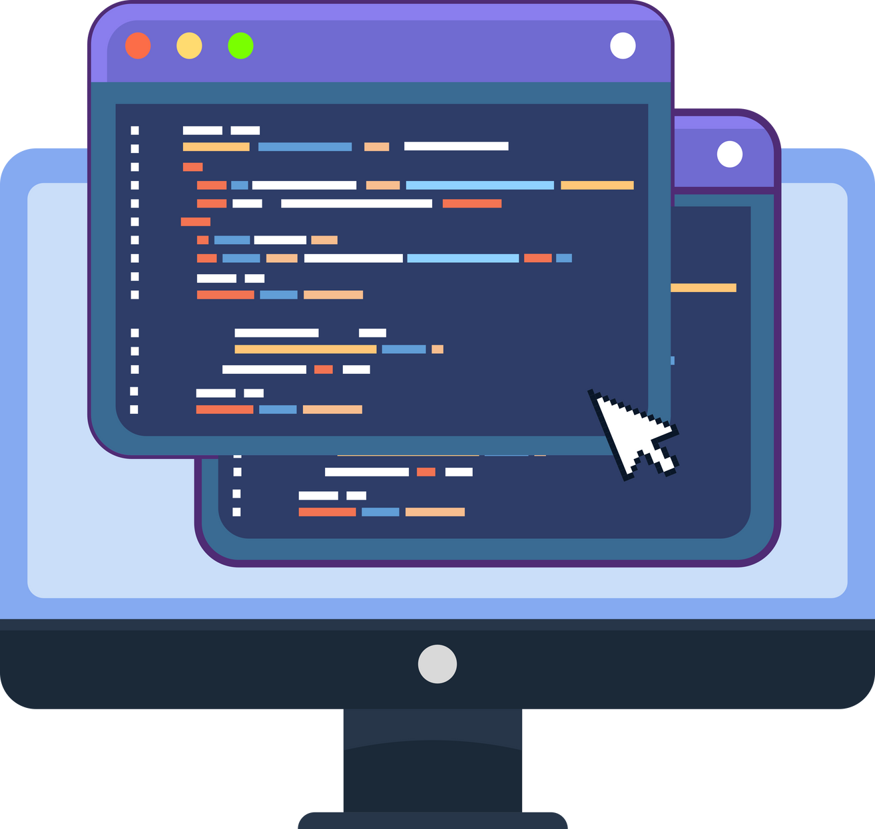
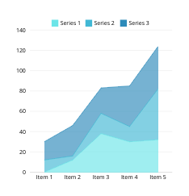
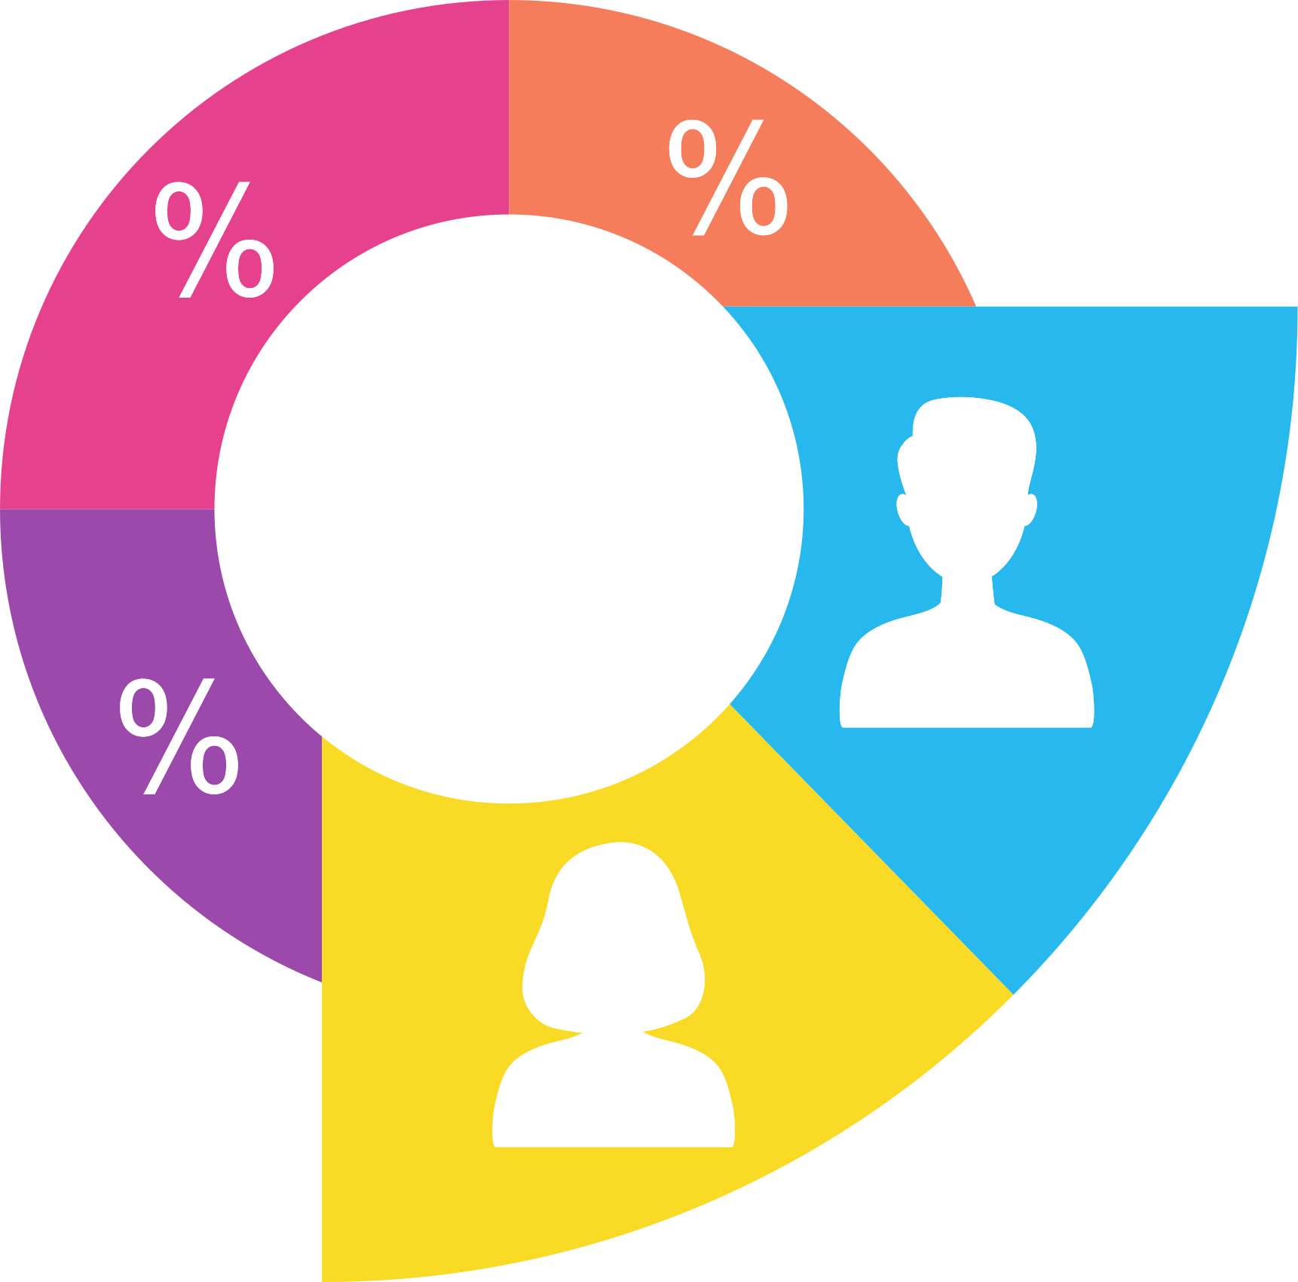
•Data in several formats, such as the number of jobs currently available for different technologies and for different places, were gathered using the Github jobs API on python
•To obtain the names of the programming languages and their yearly wages, the IBM website was scraped. The dataset from a 2019 Stack Overflow developer survey was downloaded and saved.
Methodology
•Python was used to clean and analyze the data. To assess the distribution of data, the presence of outliers, and the correlation between various columns in the dataset, an exploratory data analysis was carried out.
•Charts, graphs, and dashboards were created using Python and Cognos analytics to visualize the data. All the python analyses were carried out on Jupyter notebook through visual studio.

Slide 6

Results

Slide 7
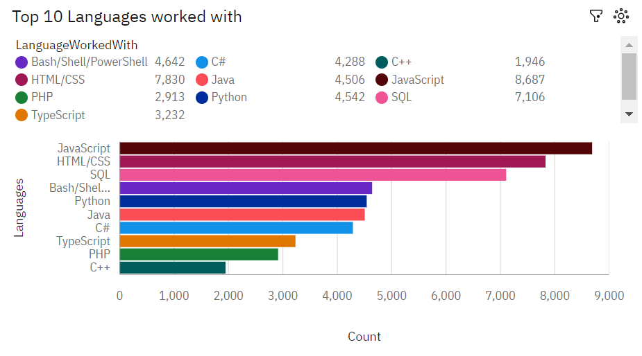
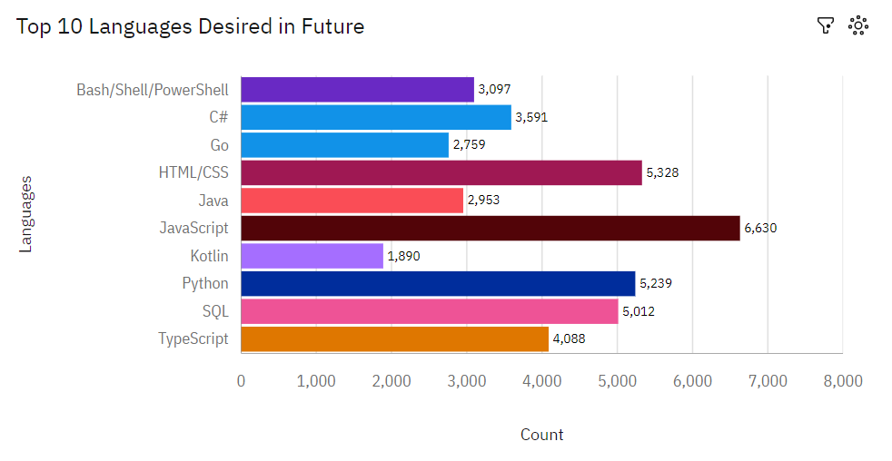
Programming Languages Trends
Current Year
Next Year

Slide 8
PROGRAMMING LANGUAGE TRENDS - FINDINGS & IMPLICATIONS
Findings
Implications
Javascript, HTML/CSS, SQL, Shell languages and Python are the most used languages currently.
Javascript, HTML/CSS, Python, SQL, and Typescript will be the most used languages next year and future years.
Python will have more demand than SQL next year.
Javascript and HTML are used for web development which means that web development as a tech skill has the highest demand, especially as Typescript is getting viral.
Python is gaining more and more traction due to the increase in demand for AI and ML skills.
SQL is the still the most relevant language for data professionals. It is important for aspiring data analysts, scientists, business analysts etc to have SQL skills.

Slide 9
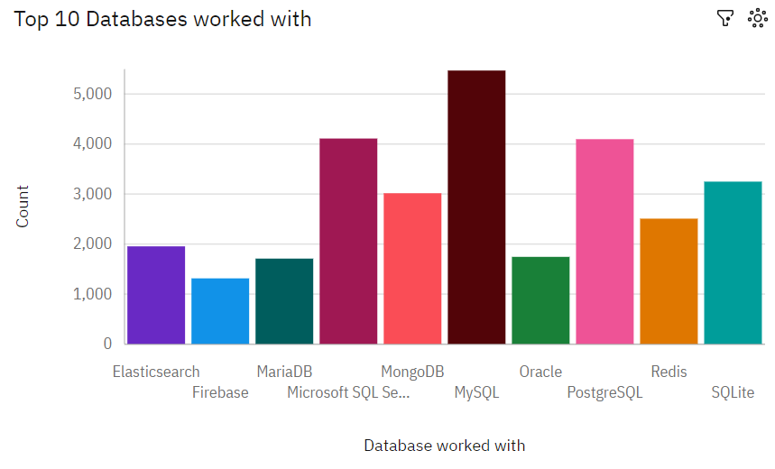
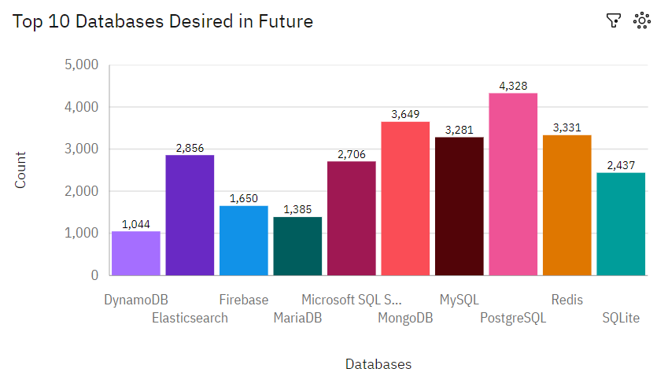
Database Trends
Current Year
Next Year

Slide 10
DATABASE TRENDS - FINDINGS & IMPLICATIONS
Findings
Implications
MySQL, Microsoft SQL server, Postgre SQL, SQLite and MongoDB are the top 5 most used databases at the moment.
However, Postgre SQL, MongoDB, Redis, MySQL and Elasticsense are projected to become more popular in the future.
Redis and Elasticsense are relaatively new tools and are set to gain more traction in the IT space.
SQL is still a top tool to watch out for in data specialists.
Companies still prefer Open source databases.
Oracle SQL was not among the top 5. It is losing relevance as time passes.

Slide 11
Dashboards made with IBM Cognos Analytics & Google Looker Studio
IBM COGNOS ANALYTICS- Link
GOOGLE LOOKER STUDIO- Link

Slide 12
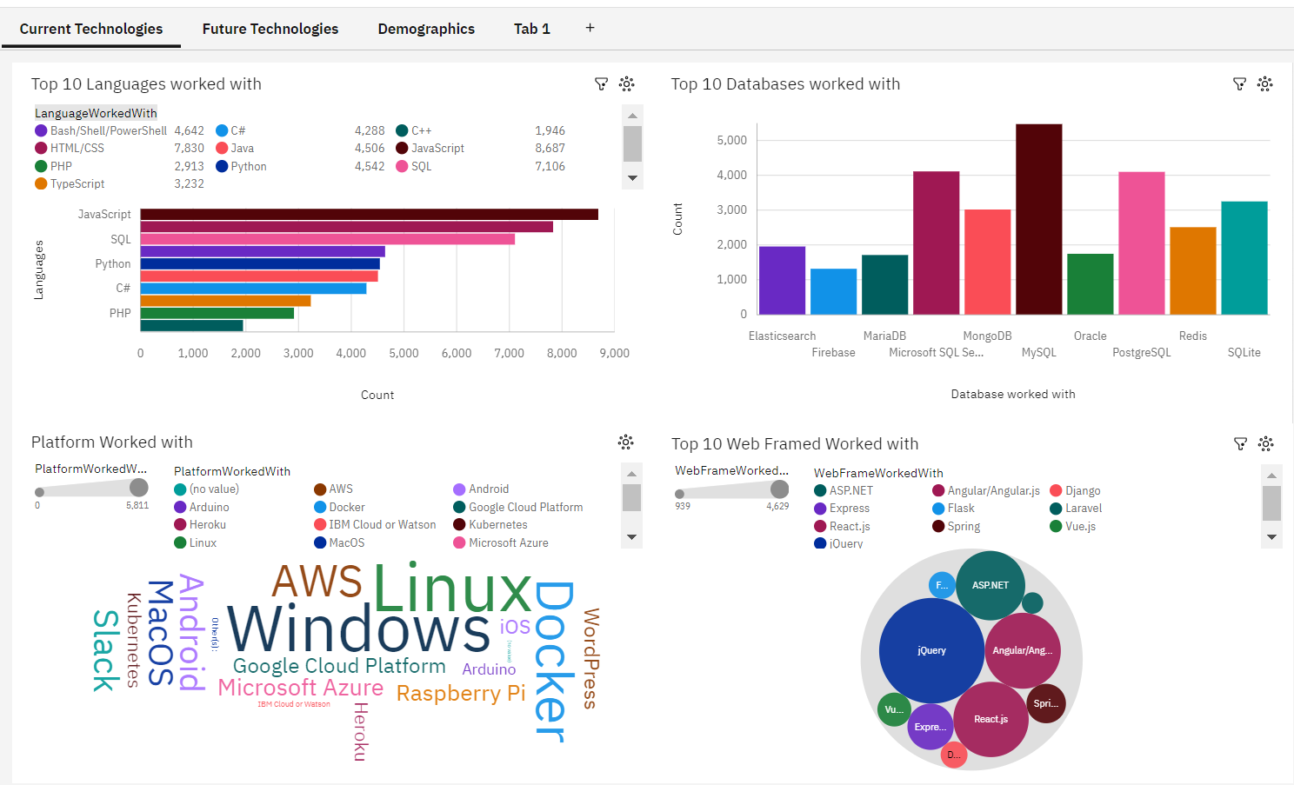
Dashboard Tab 1

Slide 13
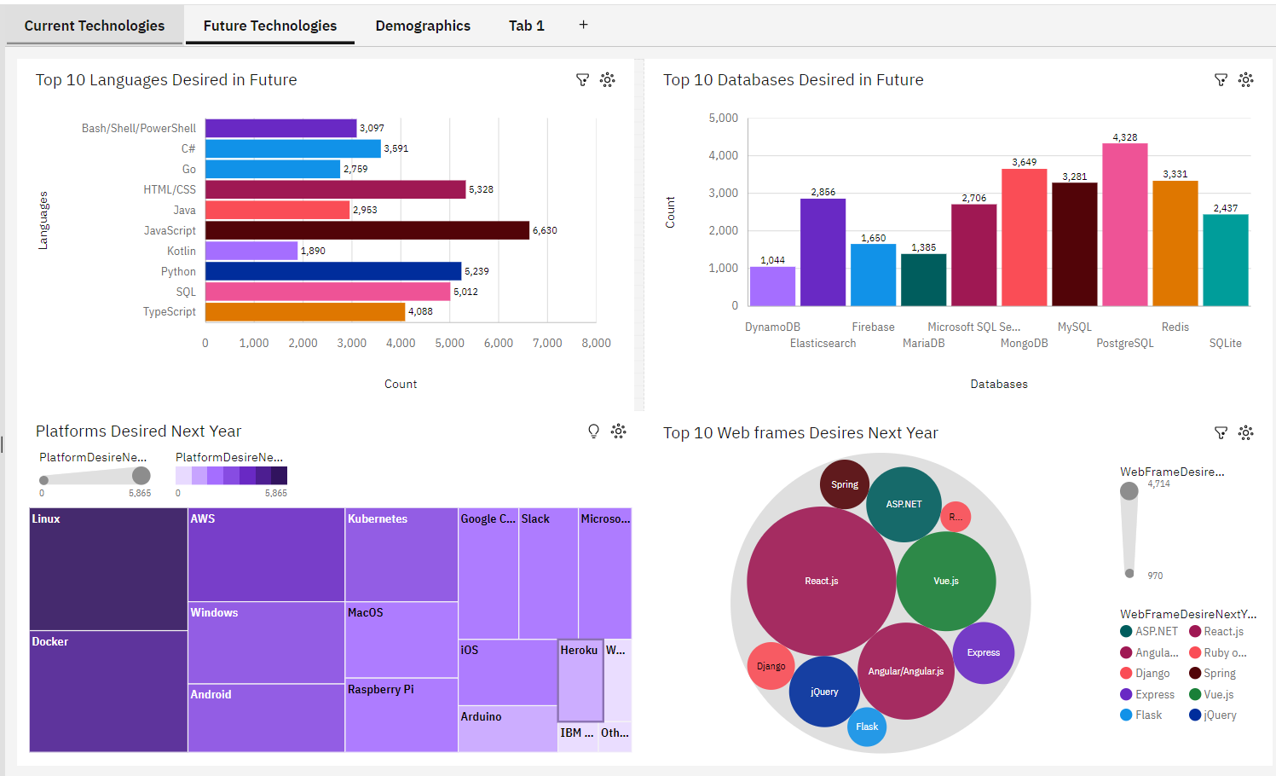
Dashboard Tab 2

Slide 14
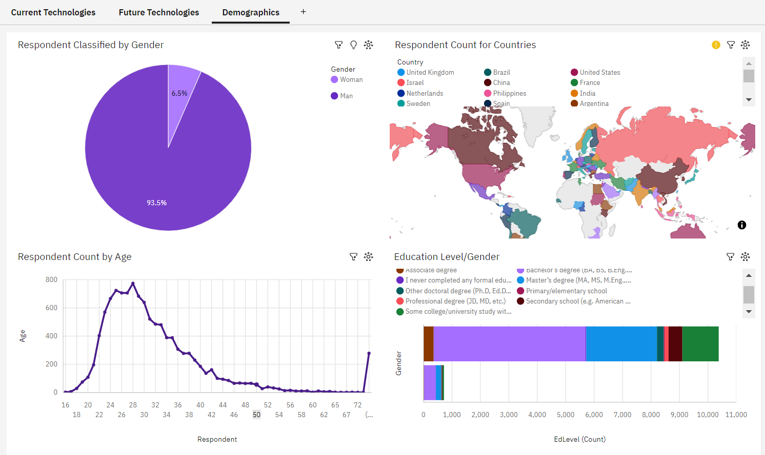
Dashboard Tab 3

Slide 15


Discussions
Upskilling in the Technology sector.
How do we close the wide gender gap in the Technology sector?
Is completing a masters or doctorate degree really a requirement?
The increasing demand for mobile development as Kotlin is getting popular.
More tech education, access and development in less developed regions in South east Asia, South America, Africa and some parts of Europe.
How relevant will Oracle SQL still be in the future?

Slide 16
Overall Findings & Implications
Findings
Implications
Most people in the IT field have a Bachelors' degree.
Web development languages are the most popular and on-demand tools in the IT field currently.
The Tech sector is filled with majorly young people under 40 years of age.
Most respondents want to learn Postgre SQL and React JS next year.
It is important for data professionals to develop proficiencies in NoSQL in addition to SQL databases.
Web development is still a very lucrative skill.
Less developed countries need more access to tech trainings and education.

Slide 17
Conclusion
It is expedient to stay updated in the Tech sector as the trends keep changing over time.
The Tech sector is ever changing and more opportunities arises every trend.

Slide 18
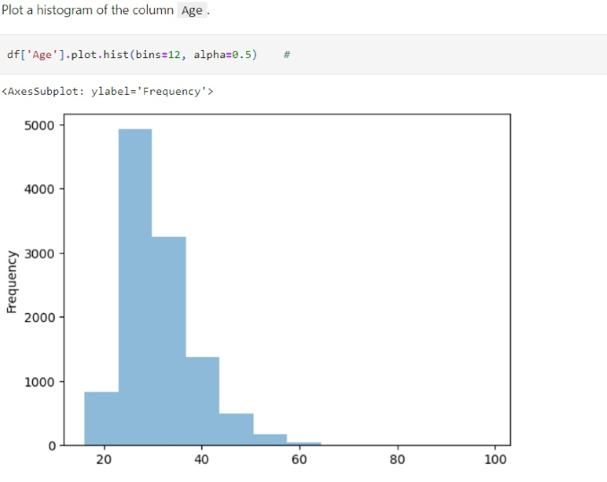
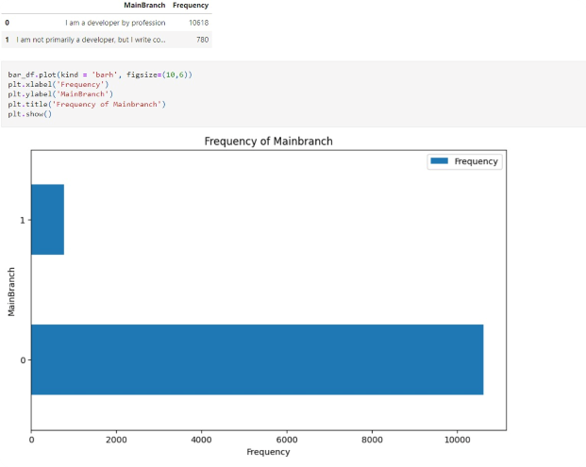
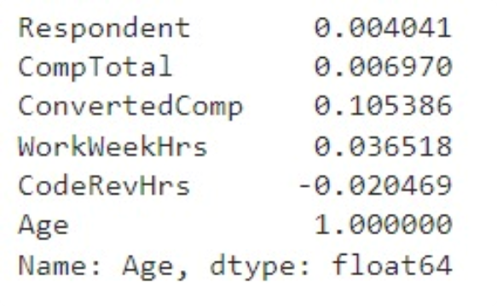
Appendix

Slide 19
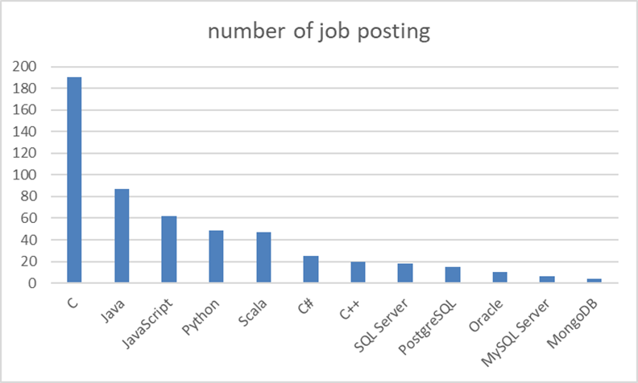
Job Posting
Bar chart presenting the job posting data collected using Github Job API.

Slide 20
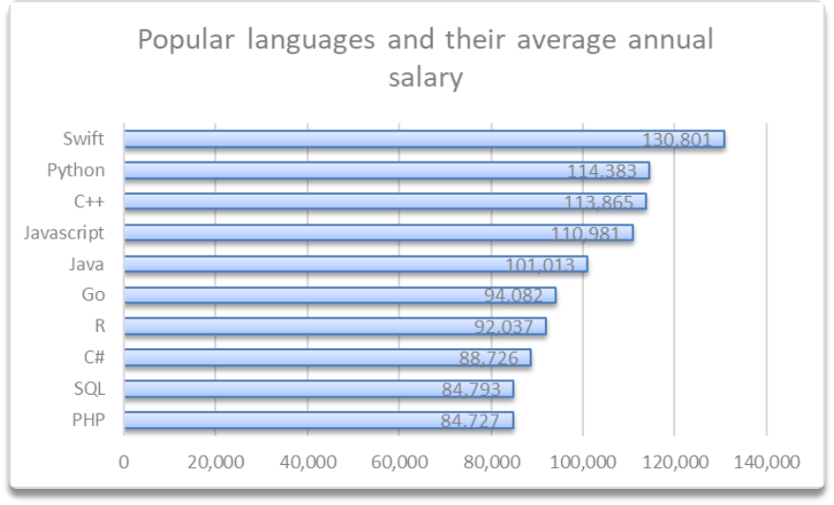
Popular Languages
Bar chart displaying popular languages and their average annual salary. The data was collected through web scraping the Github jobs data and saved in a csv file.

Slide 21
Thank You

